Slide 1
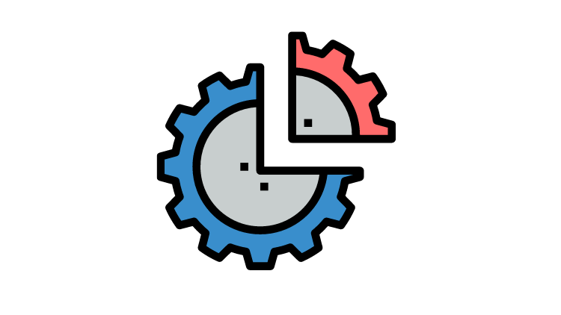
Partitioning
husseinnasser.com
Database Partitioning Explained

Slide 2
Agenda
What is Partitioning?
Horizontal Partitioning vs Vertical Partitioning
Partitioning Types
Partitioning vs Sharding
Demo
Pros & Cons
Summary

Slide 3
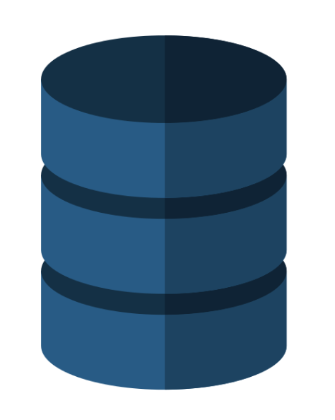

What is Partitioning?
CUSTOMERS Table
id | NAME
1 | Ali
2 | Mike
3 | Edmond
.. | ….
... | ...
700,001 | Kim
700,002 | Ali
.. | ...
1M | James
SELECT Name
FROM CUSTOMERS_TABLE
WHERE ID = 700,001

Slide 4
What is Partitioning?
CUSTOMERS_200K
id | NAME
1 | Ali
... | ..
200,000 | Edmond
CUSTOMERS_800K
id | NAME
600,001 | Nada
... | ..
700,001 | Kim
... | ...
800,000 | Tyler
SELECT Name
FROM CUSTOMERS_TABLE
WHERE ID = 700,001
CUSTOMERS_400K
Which “partition” is customer 700,001 in?
Partition CUSTOMERS_800K
id | NAME
200,001 | James
... | ..
400,000 | Smith
Split 1 million rows table into 5 tables called partitions.. Same schema
CUSTOMERS_1M
CUSTOMERS_600K
id | NAME
800,001 | Paul
... | ..
1,000,000 | Rick
id | NAME
400,001 | Nasser
... | ..
600,000 | Karen

Slide 5
Vertical vs Horizontal Partitioning
Horizontal Partitioning splits rows into partitions
Range or list
Vertical partitioning splits columns partitions
Large column (blob) that you can store in a slow access drive in its own tablespace

Slide 6
Partitioning Types
By Range
Dates, ids (e.g. by logdate or customerid from to)
By List
Discrete values (e.g. states CA, AL, etc.) or zip codes
By Hash
Hash functions (consistent hashing)

Slide 7
Horizontal Partitioning vs Sharding
HP splits big table into multiple tables in the same database, client is agnostic
Sharding splits big table into multiple tables across multiple database servers
HP table name changes (or schema)
Sharding everything is the same but server changes

Slide 8
Demo - Example with Postgres
Spin up a postgres instance
create a table and Insert 10 million rows
Create partitions

Slide 9
Pros of Partitioning
Improves query performance when accessing a single partition
Sequential scan vs scattered index scan
Easy bulk loading (attach partition)
Archive old data that are barely accessed into cheap storage

Slide 10
Cons of Partitioning
Updates that move rows from a partition to another (slow or fail sometimes)
Inefficient queries could accidently scan all partitions resulting in slower performance
Schema changes can be challenging (DBMS could manage it though)

Slide 11
Summary
What is Partitioning?
Horizontal Partitioning vs Vertical Partitioning
Partitioning Types
Partitioning vs Sharding
Pros & Cons

